Slide 1
SCSA1104- Problem Solving Technique with C and C++
By
Dr.T.Judgi,
Associate Professor,
Department of Computer Science and Engineering
Sathyabama Institute of Science and Technology

Slide 2
Problem Solving Technique
PROBLEM SOLVING
Problem solving is the systematic approach to define the problem and creating number of solutions.
The problem solving process starts with the problem specifications and ends with a Correct program.
PROBLEM SOLVING TECHNIQUES
Problem solving technique is a set of techniques that helps in providing logic for solving a problem.
Problem solving can be expressed in the form of
1. Algorithms.
2. Flowcharts.
3. Pseudo codes.
4. Programs

Slide 3
Unit - I
Algorithms
Building blocks of algorithms
- Statements, Control flow, Functions
Notation
- Pseudo code, flow chart
Algorithmic problem solving for socio economic conditions in global perspectives
Simple strategies for developing algorithms
Efficiency of algorithms

Slide 4
ALGORITHMS
Algorithms
It is a sequence of computational steps that transform the input into the output.
In other words it is a step by step procedure for solving a problem.
An algorithm is any well-defined computational procedure that takes some value, or set of values, as input and produces some value, or set of values, as output.
Problem
Algorithm
Input
Computer Program
Output

Slide 5
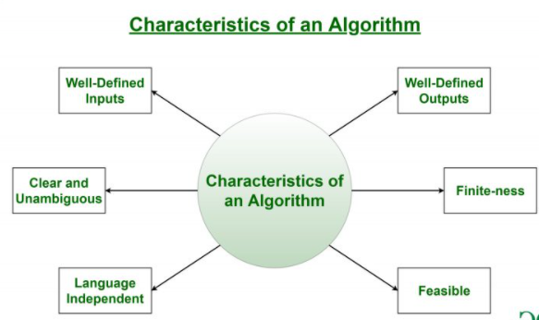
Properties of an algorithm
Must have zero / more number of input
Must produce one /more number of output
Should be written in simple English
Each and every instruction should be precise and unambiguous.
Instructions in an algorithm should not be repeated infinitely.
Algorithm should conclude after a finite number of steps.
It must be easily convert into program statement
Fig : Characteristics of an Algorithm

Slide 6
Qualities of a good algorithm
Time – Less execution time
Memory –Less usage of memory
Accuracy – Multiple algorithms may provide suitable or correct solutions to a given problem, some of these may provide more accurate results than others, and such algorithms may be suitable.

Slide 7
Advantage and Disadvantagess of algorithm
Advantages :
Provides core solution to a given problem
Easy to identify and removal of logical errors
It facilitates algorithm analysis to find the solution
Disadvantages :
In large algorithm flow of program control becomes difficult to track.
Lack in visual representation

Slide 8
Basic Algorithms

Slide 9
Common words to write an algorithm
Start,
Declare , read, get - > for input
Add, subtract,multiply,divide,compute,find - > for process
Goto , -→ for looping statement
If , else, elseif, then → for conditional statement
Display, print – >for output
stop
Input process output

Slide 10
Algorithm to prepare a coffee
Step 1: start
Step 2: take 1 cup of milk, 1tsp coffee powder
and sugar -> input
Step 3: Heat up a cup of milk
Step 4: Add 1 tsp of coffee powder and sugar to a
mug
Step 5: pour the hot milk into a mug and mix well
→steps 2,3,4 are process
Step 6: Drink coffee -> output
Step 7: stop

Slide 11
Algorithm to print a message
Write an algorithm to print “Good Morning”
1. start
2. print “Good morning”
3. stop

Slide 12
Algorithm
Write an algorithm to print your department name
Step 1: Start
Step 2: Print “Computer science and engineering”
Step 3: Stop

Slide 13
Algorithm to print a number entered by the user
1. start
2. Declare the variable a
3. Read the value of a
4. print a
5 stop

Slide 14
Algorithm to print a sum of two numbers
1.start
2. Declare the variables a,b and c
3. Read the value of a and b
4. Add the value of a and b and assign the result to c
c = a+b
5. Print c
6. stop

Slide 15
Algorithm to find the average of three numbers
1.start
2. Declare the variables a,b,c, sum, average
3.Read the values of a,b,c
4. Find the sum of a,b,c and assign the result to sum (a+b+c)
5.Divide sum by 3 and assign the result to average
(Average = A+b+c/3)
6. Print average
7. stop

Slide 16
Algorithm to find the area of circle
1.start
2. Declare the variables Area, r
3. Read the value of r
4. Area = 3.14*r*r
5. print area
6.stop

Slide 17
Algorithm to find the largest of two numbers
1. start
2. Declare the variables a and b
3. Read the value of a and b
4. If a is greater than b then print “ a is big”
if (a>b)
5. else print “b is big”
6. stop

Slide 18
Building Blocks of Algorithm

Slide 19
Building Blocks of Algorithm

Slide 20
Building Blocks of Algorithm
1.
Data
2.
Variables
3.
Control Flow
4.
Functions
Basic Terms
Data – values to be processed
Variable – Memory box to hold value
Control flow – Order of execution of statements
Functions – Block of statement to perform a task
Algorithms can be constructed from the following building blocks
Instructions / Statements
State
Control Flow
Sequential control flow
Selection control flow
Iteration control flow
Functions

Slide 21
Instructions / Statements
Single action
Steps which solves a particular problem.
Statement consist of
- Description of the problem
- Setup
- Parameters
- Execution
- Conclusion

Slide 22
Example - Statement
Example : To find the sum of two numbers
Description of the problem:
To find the sum of two numbers
Setup
Two numbers required for addition and one variable for storing the
result.
Parameters:
Read first number
Read the second number
Execution:
Calculate the sum of two numbers (a,b)
Result = a+b
Conclusion:
The desired output is the sum of two numbers which is stored in the
variable result.

Slide 23
State
Definition: Condition of algorithm at a moment in a time
Algorithm can be in any one of the following states
START state
INPUT state
PROCESS state
OUTPUT state
STOP state
Fig: State Transition
START
INPUT
PROCESS
OUTPUT
STOP

Slide 24
Example - State
Example : To find the sum of two numbers
Step 1: Start -> START State
Step 2: Read a, b -> INPUT state
Step 3: c = a + b -> PROCESS state
Step 4 : Print c -> OUTPUT state
Step 5 : Stop -> STOP state

Slide 25
Control Flow
The order of statement execution and direction of flow of programs
There are three types of control flow
1. Sequential control flow
2. Selection control flow
3. Repetition control flow

Slide 26
Sequential control flow
The steps of an algorithm are carried out in a sequential manner
In sequential, the direction of flow is straight line
Each step executed exactly once
The following figure shows sequential control flow.
Statement 1
Statement 2
Statement 3

Slide 27
Example – Sequential control flow
Example : To find the sum of two numbers
Step 1 : start
Step 2 : Read a and b
Step 3 : Add the value of a and b
c = a+b
Step 4 : Print C
Step 5 : Stop

Slide 28
To find the sum of two numbers
Step 1 : Start
Step 2 : Declare the variables a, b, c
Step 3 : Read the values a and b
Step 4 : Add a and b and assign the result to c
c = a+b
Step 5 : Print c
Step 6 : Stop

Slide 29
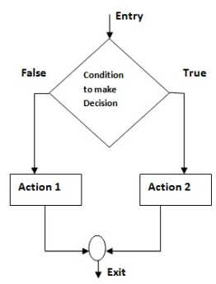
Selection Control Flow
The program control to be transferred to a specific part of the program based on the condition
Also known as Decision / Selection /Branching / Condition
Example : To find the biggest of two numbers
Step 1 : start
Step 2 : Read a and b
Step 3 : If a > b then print “a is biggest” 10>5 a is big
Step 4 : Else print “b is biggest”
Step 5 : Stop

Slide 30
Repetition control flow
One or more steps are performed repeatedly
The looping process can either be one or multiple times based on the condition
Example : Algorithm to print numbers from 1 to 5
Step 1 : start
Step 2 : Initialize i=0
Step 3 : Increment i = i+1
Step 4 : print i
Step 5 : If i <=5 then goto step 3
Step 6 : Else goto step 7
Step 7 : Stop

Slide 31
Looping Statement
Why do we need?
Looping statements consists of three parts
Initialization
Condition
Increment / Decrement
Syntax
for(initialization ; condition; increment/decrement)
{
Block of code/body of the loop
Statement 1 ;
Statement 2;
}

Slide 32
Flow of execution of for loop
Step 1 :Initialization is executed first and only once.
Step 2 :Condition is evaluated. If the condition is false, the body of the loop does not execute and the flow of control transferred to the next statement just after the loop.
Step 3: If it is true the body of the loop is executed. After execution, the control is transferred to the increment statement.
Step 4: After the execution of increment statement, the loop control value is incremented. So the condition is evaluated again. If its true the loop executes and the process repeats until the condition becomes false.
Hint
Initialization
Condition – true- body of the loop – increment – condtion
Condition – false –come out of the loop

Slide 33
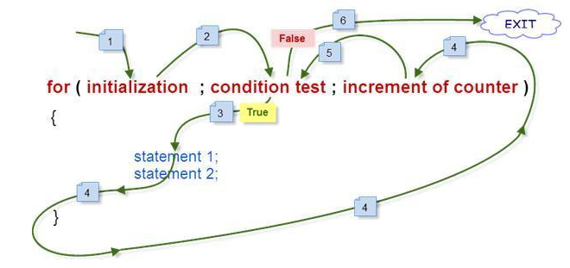
Flow of execution of for loop

Slide 34
Example for for loop
Initialization i = 1 | Condition (i < 5) | Output Print i | Increment i++ i=i+1
i=1 | 1<5(T) | 1 | i=1+1 = 2
i=2 | 2<5(T) | 2 | i=2+1 = 3
i=3 | 3<5 (T) | 3 | i=3+1 = 4
i=4 i=5 | 4<5 (T) 5<5 (F) | 4 | i=4+1 = 5

Slide 35
Functions
A function is a block of organized, reusable code which is used to perform a task.
It provides better modularity
It is also called as methods, routines, procedure.
Advantages:
Avoid repetition of code
Divide a complex problem into a simple one
Chances of error is less
Modifying a program becomes easier.

Slide 36
Function :
Example: Algorithm for addition of two numbers using function
Main function ()
Step 1: Start
Step 2: Call the function add ()
Step 3: Stop
The above algorithm is to call the function add. This function is called as Main function or calling function.
Subfunction add ()
Step 1: Function start
Step 2: Get two numbers as input and store it in to a and b
Step 3: Add the numbers a & b and store the result in c
Step 4: Print c
Step 5: Return.

Slide 37
Notation
1. Pseudo code
2. Flowchart

Slide 38
Overview
Pseudo code
Keywords
Guidelines to write pseudo code
Advantages
Disadvantages
Control Flow
Sequential control flow
Selection control flow
Repetition Control flow

Slide 39
Pseudo Code
Pseudo –False.
Code- Set of Instructions.
A way of describing an algorithm
It is an outline of a program
Avoids language specific elements (not based on programming language)
Pseudo code can’t be compiled or executed
There is no standard for the syntax of pseudo code
Definition
Pseudo code is a compact and informal high level description of an algorithm that uses structural conventions of a programming language.

Slide 40
Keywords to write pseudo code
- Keywords should be capitalized
Start : BEGIN
Stop : END
Input : INPUT, GET, READ
Initialize : SET, INITIALIZE
Calculate : COMPUTE, CALCULATE, DETERMINE, ADD,
SUBTRACT, MULTIPLY, and DIVIDE
Output : OUTPUT, PRINT, DISPLAY
Selection : IF, ELSE, ENDIF
Iteration : WHILE, ENDWHILE, FOR, ENDFOR
Increment : INCREMENT

Slide 41
Guidelines for writing a pseudo code
Write one statement (single action) in a line
Indent to show hierarchy
The programmer may use their own style for writing a pseudo code.
It never use the syntax of any programming language.

Slide 42
Advantages
Pseudo code is program/language independent.
There is no Standard syntax.
Pseudo code cannot be compiled or executed.
It is easy to translate pseudo code into a programming language.
It can be easily modified as compared to flowchart.
Simple and compact

Slide 43
Disadvantages
It is not visual.
We do not get a picture of the design.
There is no standardized style or format.
For a beginner, it is more difficult to follow the logic or write pseudo code as compared to flowchart.

Slide 44
Algorithm vs Pseudo code
Algorithm
Pseudocode
Sequence of steps that provides a solution for a problem
Written in natural language
Representation of algorithm
Written in a format related to programming language
Converting pseudo code to program is easier than algorithm

Slide 45
Control Structures used in pseudocode
There are three control flow used in pseudo code
Sequential control flow
Selection control flow
Iteration control flow

Slide 46
Pseudo code to Add two numbers
The steps of an algorithm are carried out in a sequential manner
In sequential, the direction of flow is straight line
Each step executed exactly once
Example for sequential control flow
BEGIN
DECLARE a,b,c
GET a, b
COMPUTE c=a+b
PRINT c
END

Slide 47
Pseudo code to find biggest of two numbers
The program control to be transferred to a specific part of the program based on the condition
Also known as Decision / Selection /Branching / Condition
Example for selection control flow
BEGIN
DECLARE the variables a and b
READ a and b
IF a>b THEN
PRINT “a is big”
ELSE
PRINT “a is big”
ENDIF
END

Slide 48
Pseudo code to print the number 1 to n
One or more steps are performed repeatedly
The looping process can either be one or multiple times based on the condition
Example for repetition control flow
BEGIN
DECLARE i,n
READ n
FOR i <= n DO
PRINT i
i = i + 1
ENDFOR
END

Slide 49
FLOWCHART
A flow chart is a pictorial or graphical or diagrammatical representation of algorithm that illustrates the sequence of operations to be performed to get a solution.
Steps are drawn in the form of different shapes of boxes.
The logical flow is indicated by interconnecting arrows

Slide 50
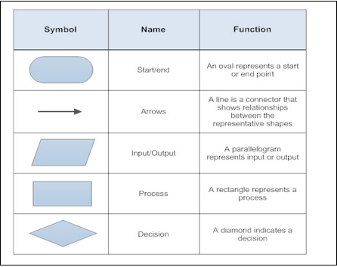
Symbols used in flowchart

Slide 51
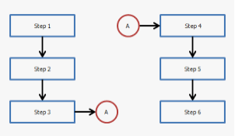
Symbols used in flowchart
Connector -

Slide 52
Flowchart -Advantages
Advantages:
Flowcharts help in communicating the logic of a program in a better way.
The problems can be analyzed effectively with the help of flowchart.
Flowcharts serve as good program documentation.
The flowchart is a blueprint for the programmer to code efficiently.
Flowcharts help in debugging process.

Slide 53
Flowchart - Disadvantages
Disadvantages:
The flowcharts are complex and clumsy when the program is large or complicated.
Altering or modifying the flowcharts may require re-drawing completely.
The cost and time taken to draw a flowchart for larger applications are expensive.

Slide 54
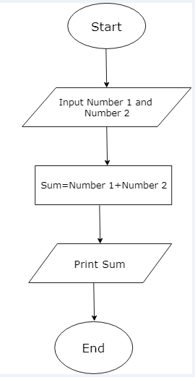
Sequential- Flowchart for adding two numbers

Slide 55
Selection- Find the largest of two numbers
Selection
Start
Read a and b
a > b
True
False
Print a
Print b
Stop

Slide 56
Iteration- Flowchart to print the number 1 to 5
Start
For Loop
i = 1
i < 5
False
True
Print i
i = i +1
Stop

Slide 57
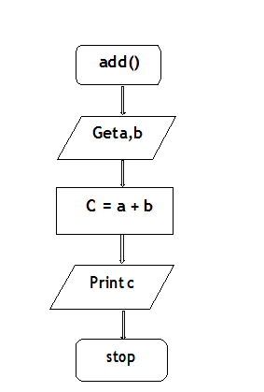
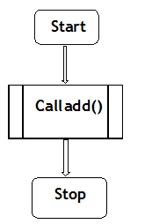
Flowchart to add two numbers using function
Calling Function Called Function

Slide 58
To find the sum of two numbers
Algorithm
Pseudo code
Step 1 : start
Step 2 : Read a and b
Step 3 : Add the value of a and b
c = a+b
Step 4 : Print c
Step 5 : Stop
BEGIN
DECLARE a,b,c
GET a, b
COMPUTE c=a+b
PRINT c
END

Slide 59
Simple strategies for developing algorithms

Slide 60
Simple strategies for developing algorithms
There two strategies for developing an algorithms
1. Iterations
2. Recursions
1. Iterations:
A sequence of statements is executed until a specified condition is true is called iterations.

Slide 61
Looping Statement
Looping statements consists of three parts
Initialization
Condition
Increment / Decrement
Syntax
for(initialization ; condition; increment/decrement)
{
Block of code/body of the loop
Statement 1 ;
Statement 2;
}

Slide 62
Flow of execution of for loop
Step 1 :Initialization is executed first and only once.
Step 2 :Condition is evaluated. If the condition is false, the body of the loop does not execute and the flow of control transferred to the next statement just after the loop.
Step 3: If it is true the body of the loop is executed. After execution, the control is transferred to the increment statement.
Step 4: After the execution of increment statement, the loop control value is incremented. So the condition is evaluated again. If its true the loop executes and the process repeats until the condition becomes false.
Initialization
Condition – true- body of the loop – increment – condtion
Condition – false –come out of the loop

Slide 63
Flow of execution of for loop

Slide 64
Example for for loop
Initialization i = 1 | Condition (i < 5) | Output Print i | Increment i++ i=i+1
i=1 | 1<5(T) | 1 | i=1+1 = 2
i=2 | 2<5(T) | 2 | i=2+1 = 3
i=3 | 3<5 (T) | 3 | i=3+1 = 4
i=4 i=5 | 4<5 (T) 5<5 (F) | 4 | i=4+1 = 5

Slide 65
Pseudo code to print the number from 1 to n
BEGIN
GET n
INITIALIZE i=1
FOR (i<=n) DO
PRINT i
i=i+1
ENDFOR
END

Slide 66
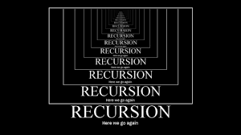
Recursions
Recursions:
A function that calls itself again and again is known as recursion.
Recursion is a process by which a function calls itself repeatedly until some specified condition has been satisfied.
Recursion is a technique that solves a problem by solving a smaller problem of the same type

Slide 67
Recursion
Main Function
main()
{
recursion(); calling function
}
Sub function
recursion() Called function
{
……
……
recursion();
…..
}
Step 1
Step 2
Step 3

Slide 68
Logic to find factorial of n number
5! = 5*4*3*2*1 =120
Logic to find factorial using for loop
5! = 5*4*3*2*1
Fact =1
For (i=1;i<=n; i++)
{
fact = fact*i;
}

Slide 69
Example for factorial using for loop
for(i=1;i<n; i++){
Fact = fact*i; }
Step | i=1 | i<=n | Fact=fact*i | ouput | i++ i=i+1
1 | i=1 | 1<=5 (T) | Fact=1*1= 1 | 1 | i=1+1 =2
2 | i=2 | 2<=5(T) | Fact=1*2 = 2 | 2 | i=2+1=3
3 | i=3 | 3<=5(T) | Fact=2*3=6 | 6 | i=3+1 =4
4 | i=4 | 4<=5(T) | Fact=6*4=24 | 24 | i=4+1=5
5 | i=5 | 5<=5(T) | Fact=24*5 =120 | 120 | i=5+1=6

Slide 70
Recursion using function
5! =5*4*3*2*1 n=5
=5*4! =>5*fact(4) => n*fact(n-1)
=5*4*3! =>5*4*fact(3)
=5*4*3*2! =>5*4*3*fact(2)
=5*4*3*2*1! =>5*4*3*2*fact(1)
If(n==1) return 1
Else
f=n*fact(n-1)
Return f

Slide 71
Algorithm to find factorial of a given number using function
Main Function
1. start
2. Get n
3. call function
4. print f
5.stop
Sub function
If(n==1) return 1
Else
f=n*fact(n-1)
Return f

Slide 72
Efficiency of an Algorithms
The efficiency of an algorithm can be measured based on the usage of different resources.
(i.e.) the number of computational resources used by the algorithm.
For maximum efficiency of algorithm,
We wish to minimize resource usage.
The two important factors considered are,
1. Time Complexity
2. Space Complexity

Slide 73
Time Complexity
The execution time depends on a number of factors such as:
Speed of the machine
Compiler and other system software tools
Operating System
Programming Language Used
Volume of data required

Slide 74
Space complexity
Space complexity can also be represented as the sum of instruction space, Data space and Environment stack space.
Instruction space: The memory space required for storing the compiled instructions. It depends on the Compiler used, compiler options and the target computer
Data space: The amount of memory space used by Constants, variables, arrays, structures and other data structures.
Environment stack space: When we use a function, we will require a stack to store the return address of the main function (Calling function). This space is the environment stack space.

Slide 75
space –time tradeoff
Space – Time or Time – Space tradeoff → is a way of solving in
less time by using more storage space
Or
Using very little space by spending more time
Some algorithms may be extremely time-efficient and others may be extremely space efficient.

Slide 76
Swapping of two numbers
Using a temp variable
a=10 b =5
t = a => t=10
a = b =>a = 5
b = t => b= 10
No.of variables = 3
No.of Operations = 3
Operations
+,-,*,/ ,%, =, <, >, <= ,>= ,AND,OR,NOT……
Without using a temp variable
a =10 b = 5
a = a+b =>a =15
b = a-b => b =15-5 =10
a = a-b => a =15-10=5
No.of variables = 2
No.of operations =6

Slide 77
Multiplication of two numbers without using* but by using +
P = 0
for i=1 to m
p = p+n
Depends on the values of m &n.
If m<n, add n for m times
Eg. 5<10000 add 10000 for 5times
If n<m, add m for n times
Eg.10000<5 add 5 for 10000 times
Let m=5, n=10000
P = 0
for i=1 to n
p = p+m

Slide 78
Calculation of Time Complexity
{
int sum=0
for (int i=1;i<n;i++)
{
sum=sum+i
}
return sum
}
Instruction | Step count
{ | 0
Int sum=0 | 1
For (int i=0;i<n;i++) | n+1
{
Sum=sum+i | n
} | 0
Return sum | 1
} | 0
Total steps=1+n+1+n+1=2n+3

Slide 79
Calculation of Space complexity
Example Consider the following statement
{
int c= a+b 4 *3 = 12 bytes
return c 4 = 16bytes
}
Type | Size
bool, char, unsigned char, signed char, int8 | 1 byte
int16, short, unsigned short | 2 bytes
float, int32, int, unsigned int, long, unsigned long | 4 bytes
double, int64, long double | 8 bytes

Slide 80
Best case/Average Case/Worst Case
Efficiency of an algorithm
Best Case
Algorithm behavior is good Time efficient consumes less memory and CPU
5 | 10 | 15 | 20 | 23 | 30
Average Case
Algorithm behavior Average
10 | 15 | 5 | 20 | 25 | 30
Worst Case
Algorithm behavior is not good Not Time efficient consumes lot memory and CPU
30 | 23 | 20 | 15 | 10 | 5

Slide 81
Algorithmic Problem Solving For Socio Economic Conditions in Global Perspectives

Slide 82
People today have to strive hard for Providing Food for Everybody
Step 1: Start
Step 2: Estimation of people below poverty line.
Step 3: Recommendation about the type and
quantity of food from the food committee
Step 4: Decide the cost
Step 5: Generation of Revenue to meet the food
demand
Step 6: Provide food through public distribution
system at all levels.
Step 7: Get Feedback from beneficiaries as well as
public
Step 8: Go to step 2
Step 9: Stop

Slide 83
Process flow for providing food for Everybody
Fig 1: Flowchart

Slide 84
Steps for providing food for Everybody
Process A: The number of people below poverty line in each village is estimated and the total of people in each district is calculated.
Process B: The food committee will recommend the type of food to be provided and also the quantity of food.
Process C: From the above inputs, the overall cost is calculated.
Process D: The Finance committee decides how to generate the revenue needed.
Process E: Revenue is generated by implementing Tax, Import /Export duties etc.
Process F: The distribution of food is carried out through public distribution system.
Process G: Feedback is provided by the public and beneficiaries which again is an input to the process to improve the quality of the food provision

Slide 85
Thank you

